Slide 1
TEST PLAN

Slide 2
Test plan
Learning Objectives :
What is Test Plan ?
Preparing a Test Plan
Test plan Template
Test Scope
Suspension and Resumption Criteria
Test Deliverables

Slide 3
Test plan
It explains
What needs to be tested?
Why the tests are performed?
How the tests are conducted?
When the tests are scheduled?
Who does the testing?

Slide 4
Preparing test plan
Test plan acts as the anchor for the execution, tracking
and reporting of the entire testing project and covers.
What needs to be tested.
How the testing is going to be performed.
What resources are needed for testing.
The time line by which the testing activities will be performed.

Slide 5
Test plan template
Test plan identifier = tp_login_2025_v1
Introduction
Test items
Features to be tested
Features not to be tested
Approach
Item pass/fail criteria
Suspension criteria and resumption
requirements
Test deliverables
Environmental needs
Responsibilities
Staffing and training needs
Schedule
Risks and contingencies
Approvals

Slide 6
Test plan
Test Plan Identifier: Provides a unique identifier
for the document
Introduction : State the purpose of the plan,
specify the goals and objectives.
Test Items : A list of what is to be tested.

Slide 7
Test scope
Features to be tested
What is to be tested from the USERS viewpoint.
(Based on BRS QA Manager decides the Features to be tested)
Features not to be tested
What is NOT to be tested from the Users
viewpoint.
We need to identify and justify why the feature is not to be tested. The reasons could be that the features not to be included in this build or release of the Software.
(QA Manager will decide which Features not to
be tested based on BRS)

Slide 8
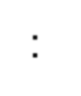
approach
Approach : This mentions the overall test Strategy/Approach for your Test Plan.
e.g. Specify the testing method (Manual or
Automated, White box or black box etc. )

Slide 9
Item Pass/Fail Criteria
Item Pass/Fail Criteria : Specify the criteria that will be used to determine whether each test item (software/product) has passed or failed testing.
To define the criteria for pass and fail, consider issues
such as the following :
How Significant is the problem. Does it affect any
critical function?
How likely is it that someone will encounter the problem?
Are there any show stopper issues?

Slide 10
Suspension and Resumption Criteria
Suspension and Resumption Criteria : Suspension criteria specify the criteria to be used to suspend all or a portion of the testing activities while resumption criteria specify when testing can resume after it has been suspended.
Example :
The testing will be suspended if mandatory network link is not available. Testing activity will resume with the Network link is made available.

Slide 11
Test Deliverables
Test Deliverables: Are nothing but all type of documents which are used in implementing the Testing it starts with sign in to sign off.
For example:
1.Test Plan 2.Test cases 3.Test log, etc ...

Slide 12
Examples of test deliverables
The different types of Test deliverables are:
Test cases Documents
Test reports
Test Plan
Test Summary Report
Test Bug Report
Test Analysis Report
Review documents
Bug Analysis report etc

Slide 13
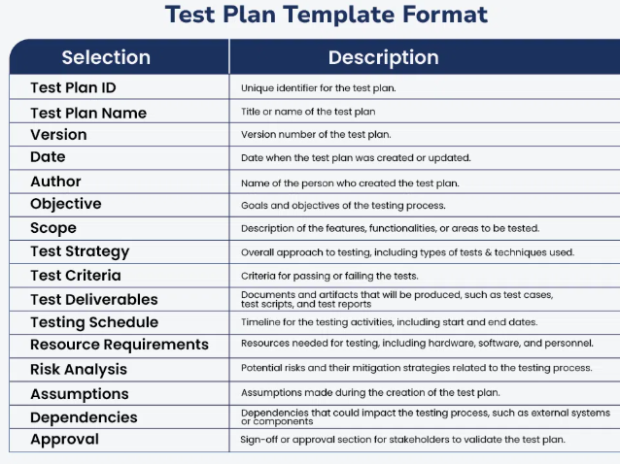

Slide 14
Environmental needs
Environmental needs :
Specify the properties of test environment: hardware, software, network etc.
List any testing or related tools.

Slide 15
Responsibilities
Responsibilities :
List the responsibilities of each team/role/individual.

Slide 16
Staffing and training needs
Staffing and training needs:
How many staff members are required to do the testing?
What are their required skills?
What kind of training will be required?

Slide 17
Schedule
Schedule :
Built around the roadmap but specific to testing
with testing milestones
When will testing start
What will be the targets/milestones pertaining to
time
When will testing cycle end

Slide 18
Risks and Contingencies
Risks and Contingencies
Any activity that is a threat to the testing schedule is a planning risk.
What are the contingencies( A provision for an
unforeseen event) in case the risk manifests itself.
What are the mitigation plans (Alternate plans) for
the risk.

Slide 19
Approvals
Approvals :
Specify the names and roles of all persons who must approve the plan.
Provide space for signatures and dates. (If the document is to be printed.)

Slide 20
Interview questions
What is a Test Plan?
What is difference between Suspension criteria
/Resume criteria and Exit Criteria?
What is Item Pass /Fail Criteria?
What the parameters of Test Plan?
What is a Test Scope?

Slide 21

Any questions?

